Slide 1

Data Driven Education
Discussion Forum Subteam
Presentation 2 - 3/31/2021

Slide 2




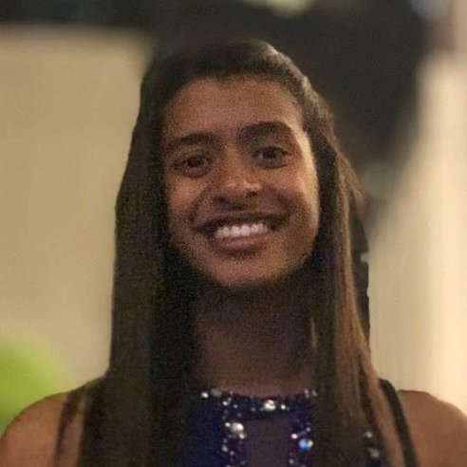

Team Members
Pratik Agrawal
Machine Learning Engineer
Aanya Khandelwal
Back-end
Developer
David Kim
Machine Learning Engineer
Sambhav Jaideep
Front-end
Web Developer
Nidhi Pai
Data Scientist
Morgan Powers
Project Manager
Notes:
All

Slide 3

Introduction
Discussion forums are used a lot in college
  Online formats
Student interaction
  Participation
  Cognitive presence
Goal: Creating a web application to be used by professors will allow the instructors to improve their courses

Slide 4
Professor/TAs Feedback
What metrics are important to professors and TAs?
3 TAs, 2 professors, 1 other
Scale: 1-7, 1 being not helpful and 7 being extremely helpful
Do certain users tend to have a higher cognitive presence score? | 6.00
Most relevant terms by topic | 5.83
Cognitive presence: how meaningful a post is | 5.83
Number of posts by a specific user | 4.83
Number of posts in a given thread | 4.67
Sentiment score: does the post have a positive or negative tone? | 3.83
Post frequency: amount of posts by week | 3.50

Slide 5
Professor/TAs Feedback
Metrics currently looked at
  Amount of questions on a specific topic
  Number of posts by a specific user (participation grade)
  Engagement
  Abstract thinking
Metrics considered important
  How active a class is overall
  Are there students that are never active?
  What type of topics get people to participate?
  Common questions/topics mentioned

Slide 6
Data Science Goals Recap
Visualizing Metrics
  Create visualizations and statistics relevant to professors & course designers
  Find features for cognitive presence models
Cognitive Presence Modeling
  Establish Baseline Performance
    Accuracy: ~70%
    Cohen's Kappa: ~.63
  Identify sources of Error
    Optimization
    Estimation
    Modeling
  Accuracy vs Interpretability
    Explore more on cognitive presence with interpretable models but sacrificing accuracy OR
    Use complex model like BERT to get better performance at the cost of interpretability
Notes:
We started with Visualizations,
Baseline Performance - It's important to have a baseline performance to set the standard for future models.
Identifying sources of error will help us make adjustments, whether this is selected features, selecting data size, or adjusting models and parameters.
We also want to create
With simple models, the number of parameters is low, and will require less data.
With complex models, the number of parameters is high, and is more likely to overfit. Also, harder to optimize!
This is due to the curse of dimensionality, as the amount of data required grows exponentially with respect to the number of features.
Optimization Error: Finding the best set of weights or parameters for a NN or specific model type.
Estimation Error: A model that performs well during training may not generalize well to the test set.
Modeling Error: Error due to model. The model may be incapable of representing reality.

Slide 7
Quick Recap
First presentation stuff
Cognitive Presence Modeling
  Establish Baseline Performance
    Accuracy: ~70%
    Cohen's Kappa: ~.63
  Identify sources of Error
    Optimization
    Estimation
    Modeling
  Accuracy vs Interpretability
    Explore more on cognitive presence with interpretable models but sacrificing accuracy OR
    Use complex model like BERT to get better performance at the cost of interpretability

Slide 8






Update 1: 2016 Kovanovic Replication
Structure matters: Adoption of structured classification approach in the context of cognitive presence classification. Lecture Notes in Computer Science (Kovanovic et al, 2015)
Postgres
psycopg2
NLTK
Notes:
Some points of progress that we've made in the 2016 Kovanovic paper replication is that we've looked into past referenced papers that go into his implementation in more detail. Specifically, we've focused on the "Structure Matters" paper, where he talks about the extraction of Discussion Context Features.
In order to extract these features, we've been setting up the environment so that we can connect to Postgres database using the psycopg2 library and import tables into pandas dataframes as well as excel files. From here, we use the nltk library and Java to run Stanford's Named Entity Recognizer.
Some challenges in replicating discussion context features are technical. Ensuring that everything works in a unified python codebase requires that we find python interfaces to help run the code for java libraries such as StanfordNER and LIWC 2015.
We also face challenges with the data. For example, code in text examples change the meaning in undesirable ways. There also are repeated examples in the data due to records of every update. Even slight changes: such as fixing of a typo in some text, a clarification of a question, or using the same reply to further a discussion can lead to similar examples, which could create models likely to overfit and artificially boost accuracy. Finally, the data is separated by posts. This is problematic because a post can have several discussions, which mean that we can no longer use timestamps to find important features such as the first, last, previous text similarity, or next text similarity of each discussion as they are only connected by post numbers. One future consideration is to represent the follow-up as a unit of discussion, but this is not currently supported by the data.

Slide 9
Update 2: Cognitive Presence Modeling
Word-Mover’s distance
  Ran the model with Word-mover’s distance using different embedding model
  Outcome: No major change in overall performance, however, distribution of precision recall across classes is different
  Challenges: Word context missing, slow inference
BERT fine-tuning
  Transfer learning by fine-tuning BERT network using PyTorch Lightning (PL)
  Outcome: Need to investigate further, but if modeled as multi-label classification, ROC-AUC ~ 0.8
  Challenges: New experience with PL, Interpretability vs Performance tradeoff
    Potential resolution: Use model agnostic frameworks like LIME to add interpretability

Slide 10
Update 3: Social Network Analysis
  Created a network graph of comments and threads with users as nodes and comments as edges
  Outcome: The edges are highly concentrated around certain nodes (See figure on next page)
  Challenges: First-time experience in Social Network Analysis, multiple dimensions to explore (time-dependency, topology of these networks, generative models, etc.)

Slide 11


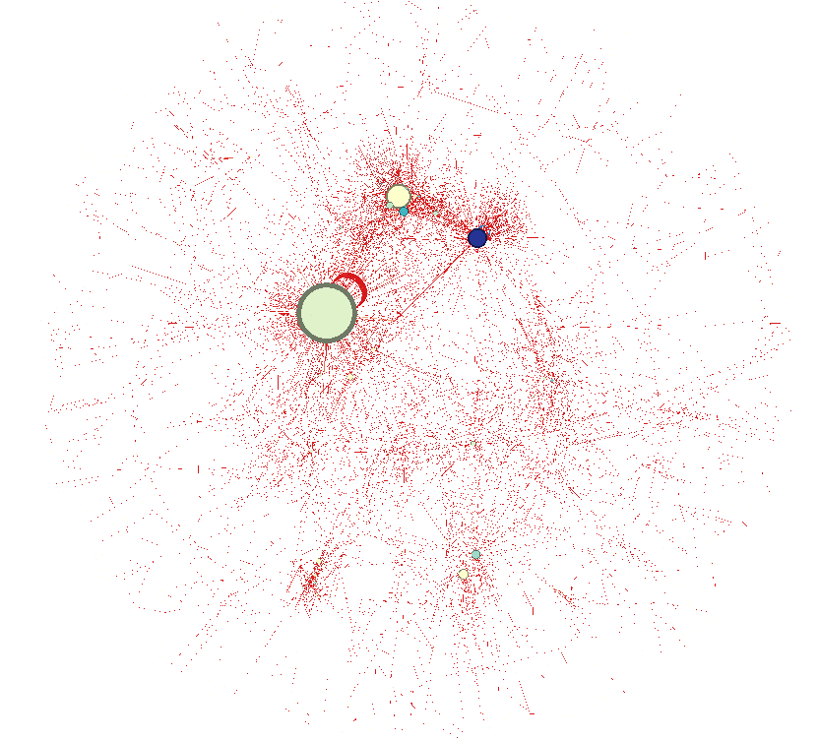
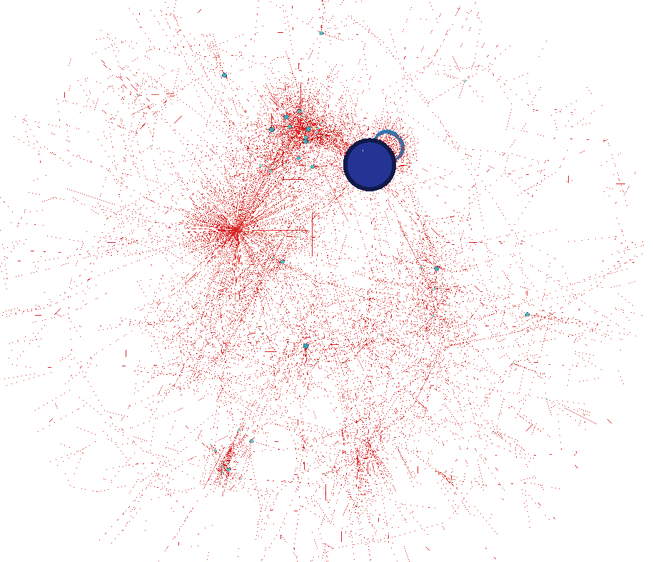
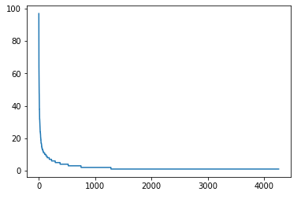
Social Network Analysis (Contd.)
Original
After filter: Degree > 5
Number of posts by a student (sorted)
Number of posts
Students index
Nodes sized by Out-degree
Nodes sized by In-degree
The engagement is highly concentrated around certain nodes acting as sources or sinks

Slide 12
Update 4: Data Visualizations
Create visualizations and statistics relevant to professors & course designers
Find features for cognitive presence models
Started with Kabir & Madria (2020) - COVID-19 tweets
Statistics
  Agreement between two coders: Cohen’s kappa, κ = .9179
  Median/mean word count by CP score: much higher for exploration and resolution
Challenges
  Figuring out what visualization & statistics are relevant
  Cleaning data - some posts still have Python code
Notes:
2 = exploration

Slide 13
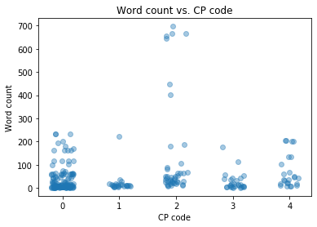
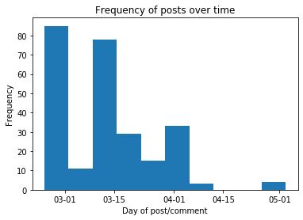
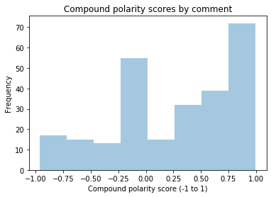
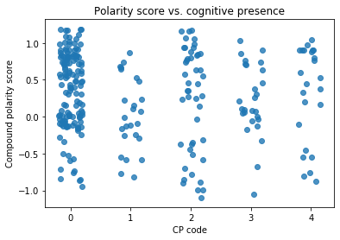

Slide 14
Data Science Goals
Data Visualizations
  Create visualizations/statistics based off of the survey
    Overall activity of class and individual activity of students
    Common questions, terms, and topics
  Use more Piazza data
Modelling goals
  Test multiple ML models using features suggested in Kovanovic’s work
  Perform experiments with the BERT model and observe generalizability on Piazza data
  Create the pipeline for fetching data directly from server DB, run model and output results to a file that can be used by Web-dev to display on the dashboard
  Define a clear problem statement for social network analysis to be explored in the next semester

Slide 15
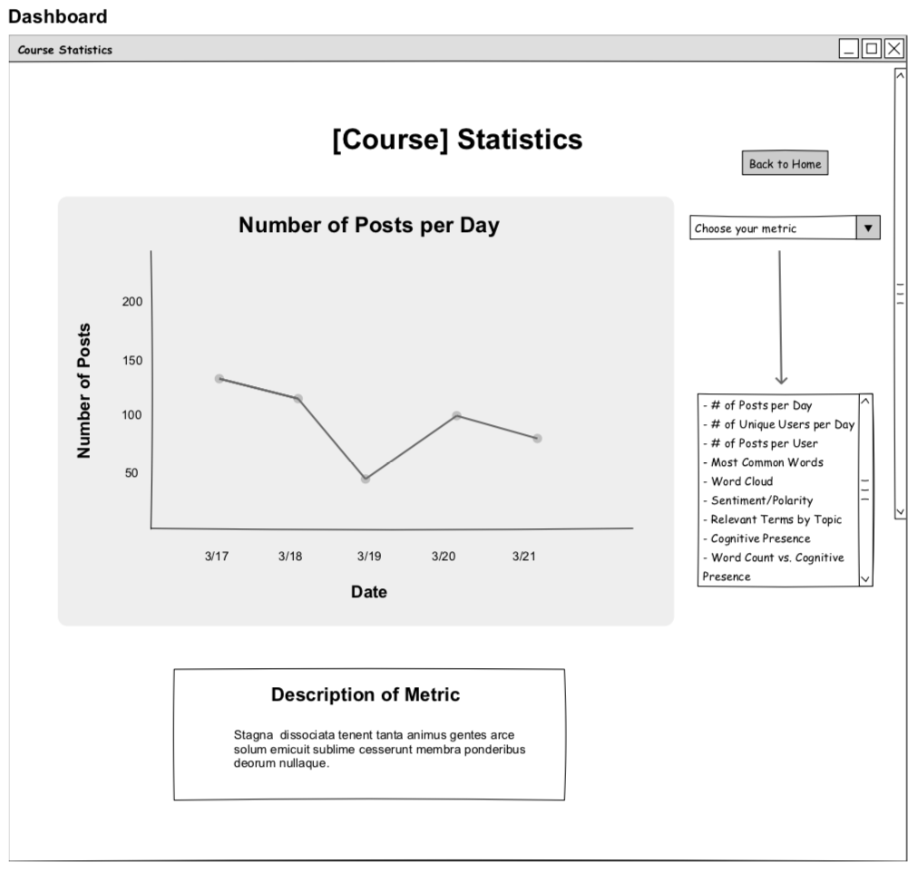

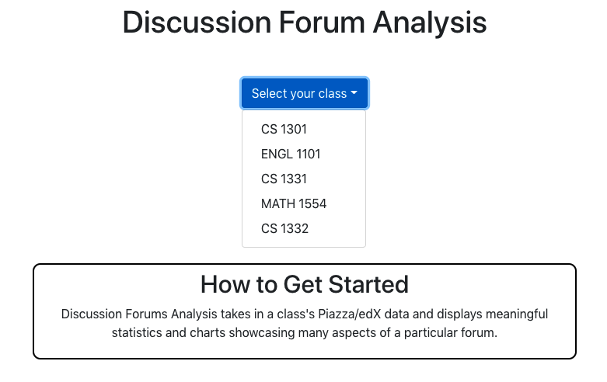
Web Development
Frontend:
  Initial wireframes
    Pencil
    feedback, reworking
  More UI/UX research
    design principles
  React frontend for web-app
    React-Bootstrap
    Material UI
    react-vis
Backend:
  Pipeline established
  Flask and SQLAlchemy
  Exploring dataset features to structure base
Wireframes
React

Slide 16
Web Development Goals
Frontend:
  finalize design, translate directly to React
    Get feedback from others (team, professors, peers)
  Get basic data visualizations into dashboard
    Experiment with different data visualization libraries
Backend:
  explore the dataset more thoroughly to find a suitable structure for the data
  experiment with sending actual data through the pipeline

Slide 17
Conclusion
Feedback
  Gave us a better idea of what metrics are important
Data Science
  Created visualizations for professors to measure engagement
  Set up the environment for setting baseline results
  Found promising preliminary results using transfer learning
Web-Dev
  Steadily moving towards working product
    Frontend design nearly finalized, Backend/database getting there
  Will need to work a bit faster to reach semester goals

Slide 18
Citations
Kabir, M. Y., & Madria, S. (2020). CoronaVis: A real-time COVID-19 tweets data analyzer and data repository.
Waters, Z., Kovanović, V., Kitto, K., & Gašević, D. (2015). Structure matters: Adoption of structured classification approach in the context of cognitive presence classification. Lecture Notes in Computer Science (Including Subseries Lecture Notes in Artificial Intelligence and Lecture Notes in Bioinformatics). https://doi.org/10.1007/978-3-319-28940-3_18

Slide 19
Questions?

Slide 20
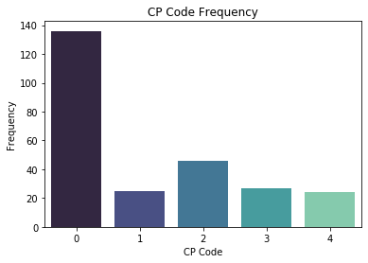
Data Science
A spiffy graphic to illustrate why you (David & Pratik) need to balance/resample the posts for CP codes in your ML stuff

